Slide 1
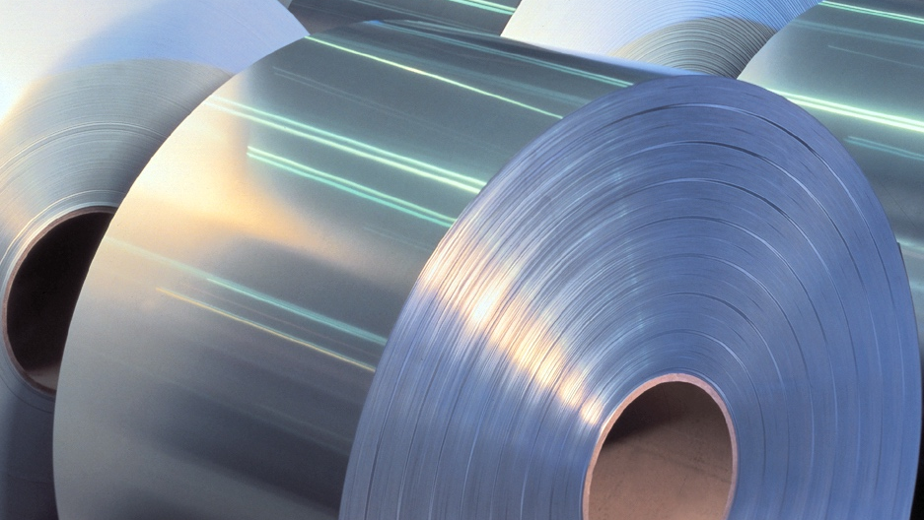


Simplifying the changeout of rc1 regen beds
2024 Summer Internship Report Out
Ashwin Sudarshan
08/22/2024

Slide 2

Introduction
Ashwin Sudarshan
Mechanical Engineering Intern
Remelt Unit
What are you studying? – Masters in Mechanical Engineering
Where are you going to school? – University of Maryland, College Park
Interests/Hobbies/Clubs – Violin, Tennis, Formula One

Slide 3
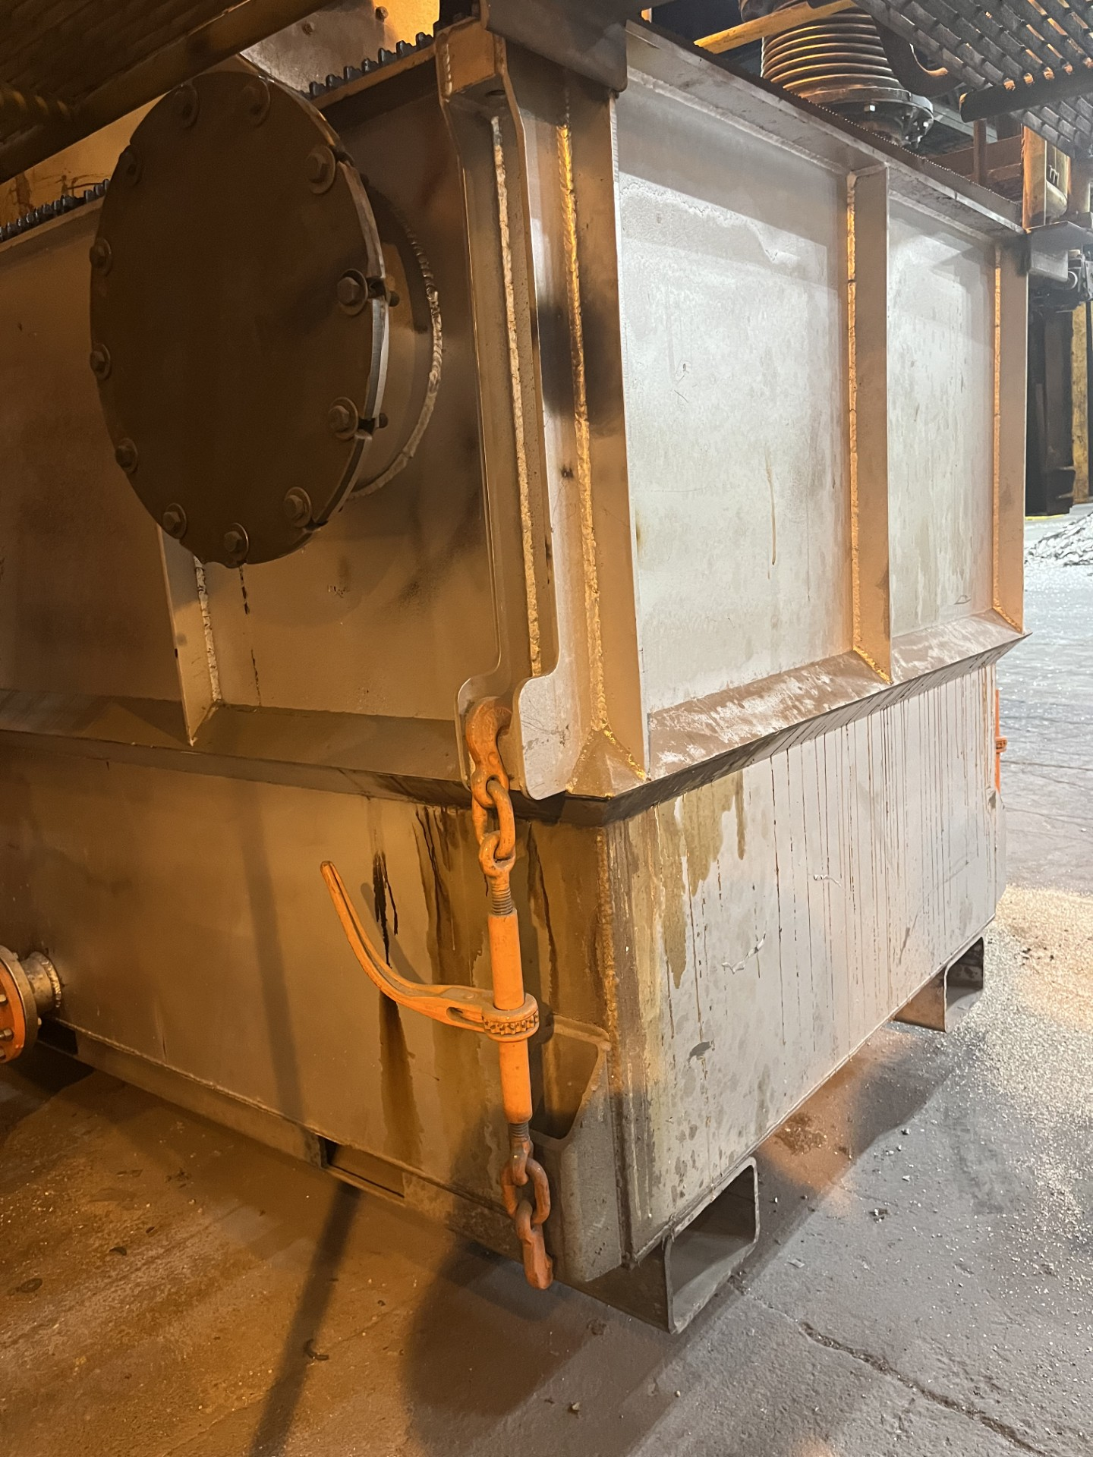
Project Outline
1
Beginning State
Difficulty with the alignment of the upper and lower regen beds
2
Target State
Easy alignment of the regen beds, falling right into slot with less time consumption
3
Solution State
Torque powered load binders can be used, so that the operators can slide the bed close enough, hook these up and align the beds
4
Current State
Furnace wall and regen beds modelled, proposed solution and next steps discussed, but not executed

Slide 4
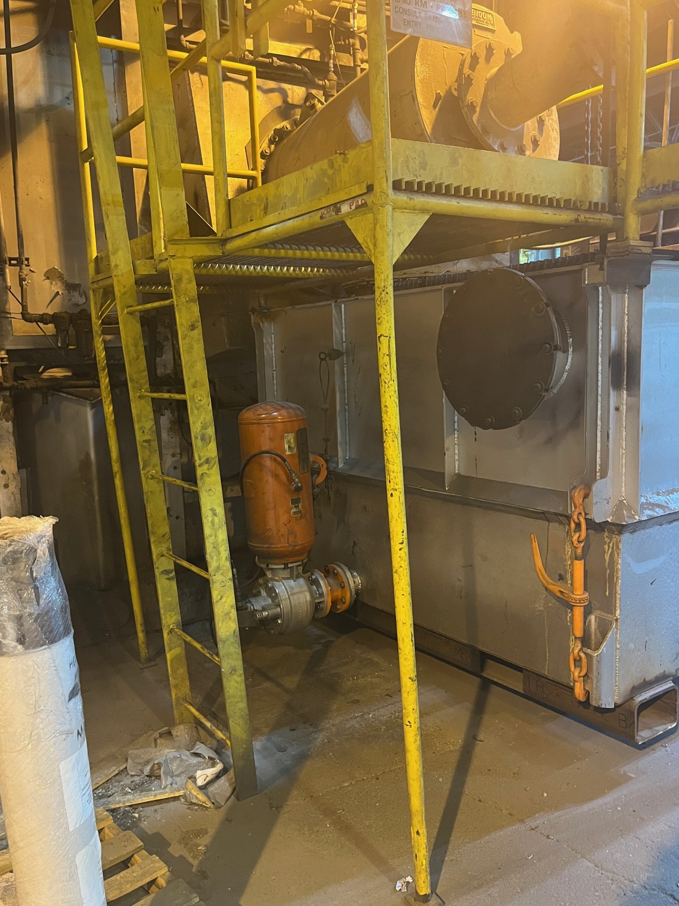
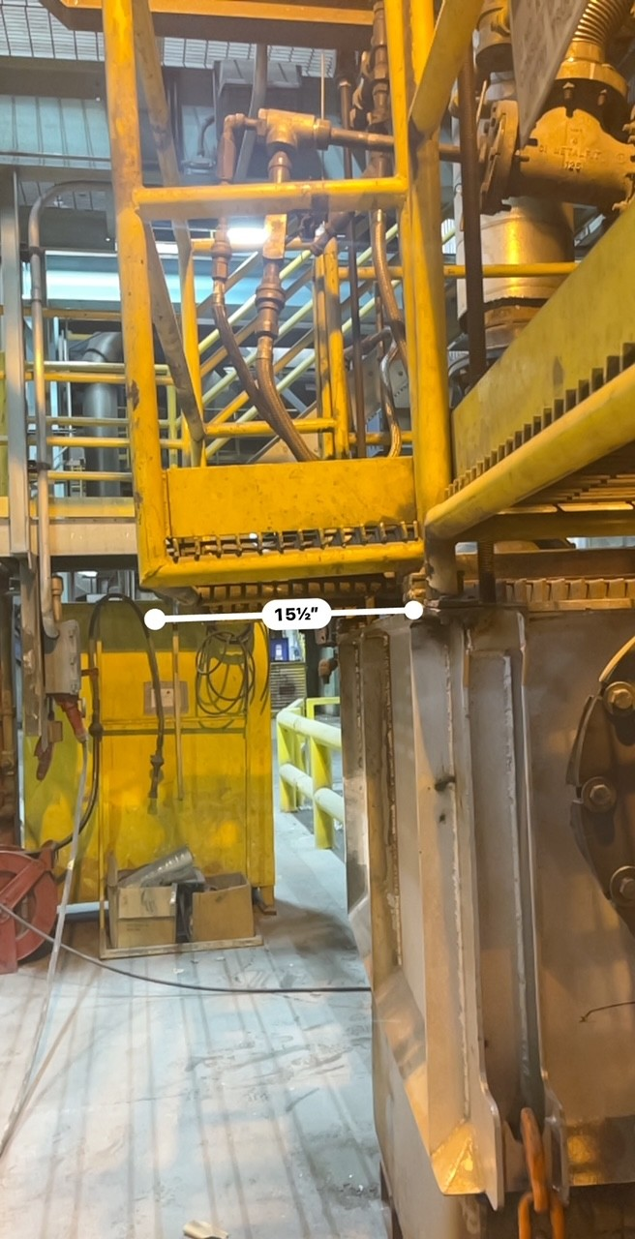
Beginning State
The lower regen bed is aligned with the upper regen bed using a fork truck
There is limited space to do so and that makes proper alignment even more challenging (manual load binders are not long enough as well)
Although the beds are not replaced very frequently, a solution is required to make this alignment easier and less time consuming

Slide 5
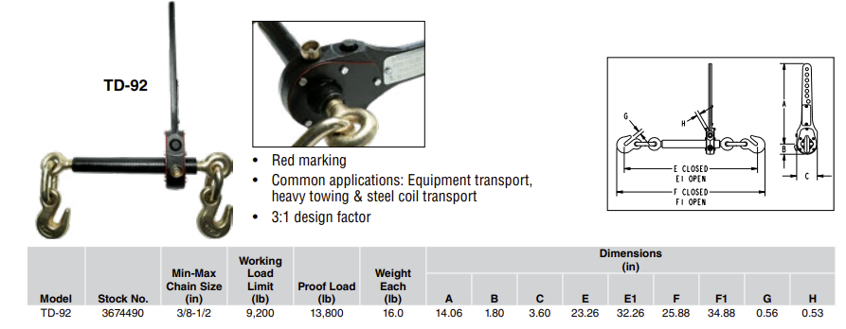
Target State
The regen beds would align with each other easily compared to earlier
The space constraint for the fork truck and the regen beds being angled wouldn’t be an issue
A torque load binder is proposed.
Operators can slide the lower bed close enough, hook the load binders up and then run them up to position.

Slide 6
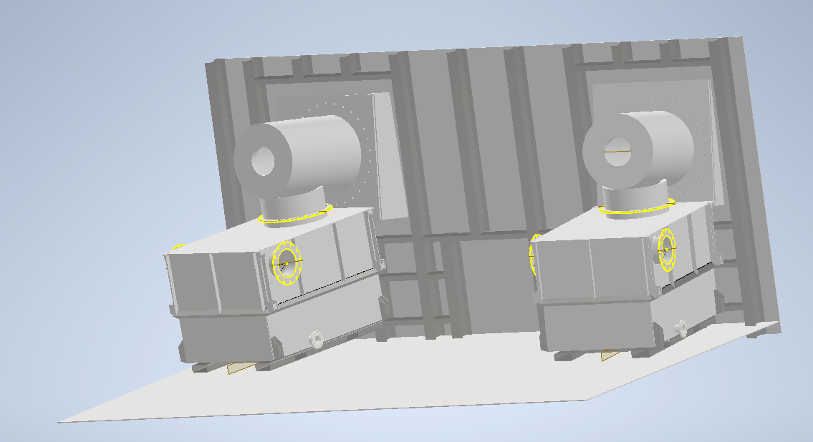
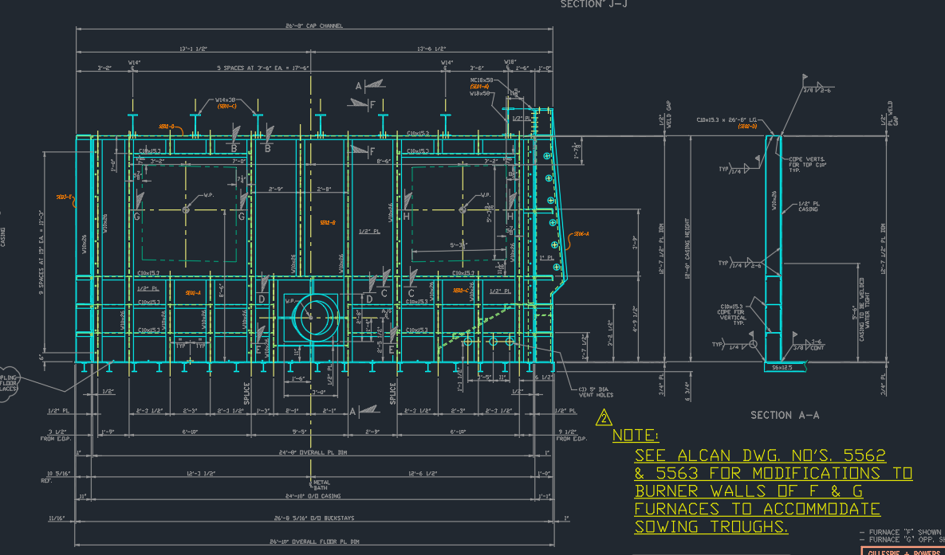
Bridging Analysis
Autodesk Inventor was used for modelling during this project
It was challenging to model on Inventor because of my previous SolidWorks knowledge which was conflicting
Plenty of AutoCAD Drawings were also referred to during the project to model the furnace wall, the burners and the regen beds.

Slide 7
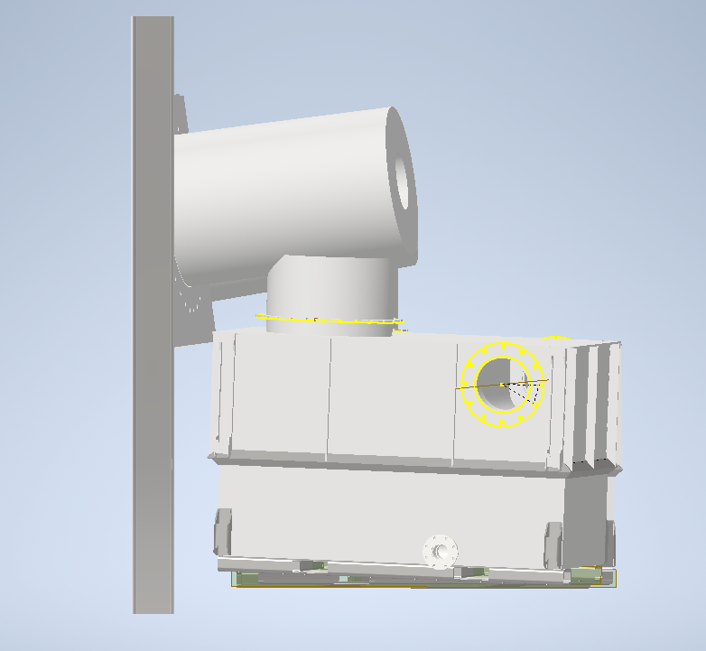
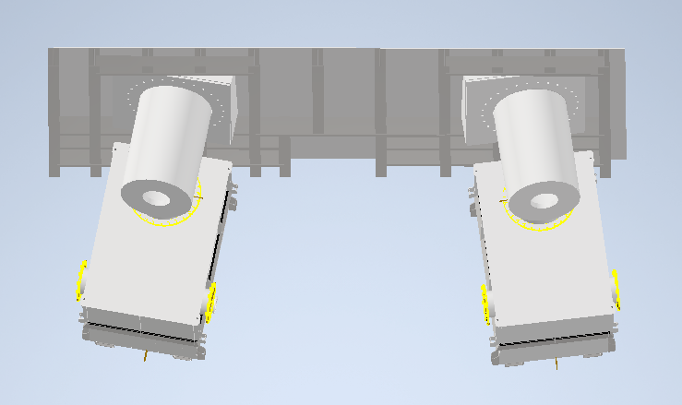
Solution Plan
First step was to model the furnace wall, followed by the burner and the metal plates.
Referred to plenty of drawings during the process
Biggest challenge was getting the angle of the plates and the burners right
Constant visits to Recycle 1 to grab actual measurements and make sure I was in the right direction
Then it was about implementing the actual solution, the torque powered load binder

Slide 8
Current State
Recycle 1 Furnace F was modeled for the first time and can be used for future purposes.
Solution is proposed, which will reduce a major hassle, but implementation has not been executed due to lack of time.
Impact on Quality, Reliability, Profit
There were certain inconsistencies that came to light because of choosing to model this, that can be improved upon.
Hours of effort will be saved if the solution is implemented correctly.
Safety concerns would also be averted when this is implemented

Slide 9
Sustainability Plan
Took maximum efforts to avoid usage of paper as much as possible, instead of printing out drawings I referred to them as a dwg file on AutoCAD

Slide 10
PROJECT 2 – Volume calculations
Volume calculations for the 20T and 60T furnaces which helps determine the weight of the metal (in lbs) from the height (inches) and vice versa accurately.
Reason for carrying this out – Calculations derived from Pi and MCS weren’t accurate.
The radar had to be adjusted according to some metal that was already present in the furnace (the metal height did not start at 0 inches due to all metal not being scraped off)
Based on my calculations, the radar was adjusted to its zero value which would be an accurate reflection of the metal weight in the furnace.
Analytical calculations were carried out, mainly on Microsoft Excel to provide a relationship between height and weight.
Coming up with a solution made operator life much easier
It also helped prevent overfilling, averting a major safety concern

Slide 11
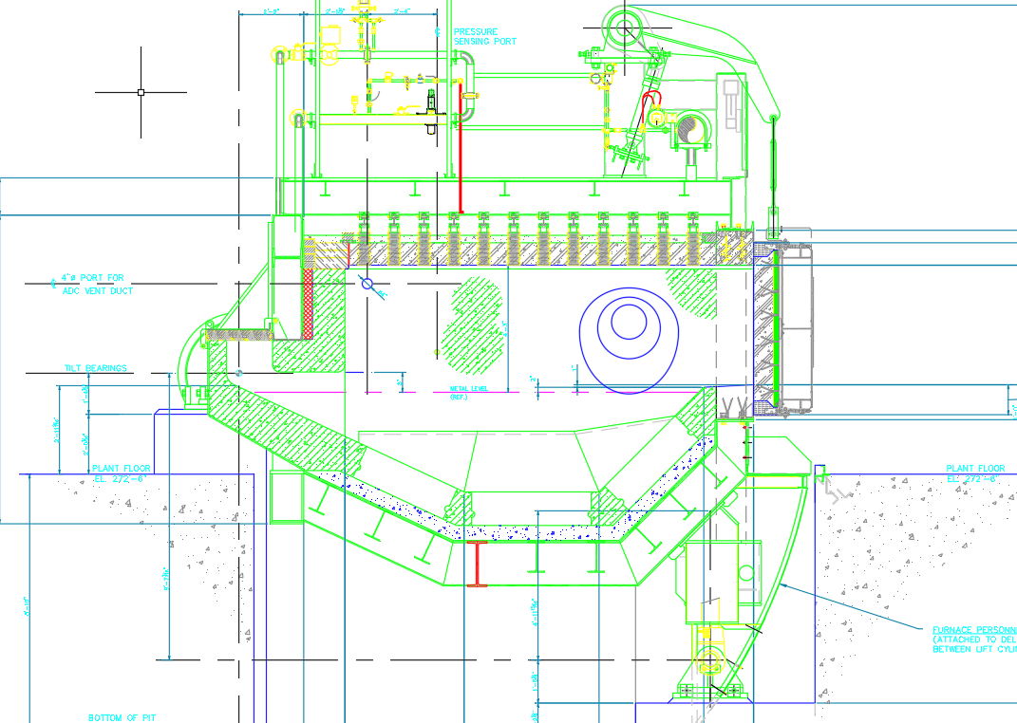
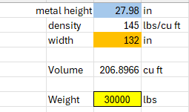
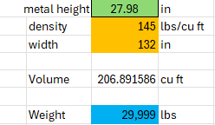
PROJECT 2 – Volume calculations
Weight to height calculation
Height to weight calculation
20T furnace drawing

Slide 12
Takeaways
Great experience overall in understanding the thinking that goes into any project
Developed my skills further at modelling, albeit this time on a new software i.e. Inventor
Strengthened my ability to read and understand CAD drawings better
With the regular interactions I had with everybody here, it improved my communication skills as well
The culture and discipline here has set an example for me that is worth remembering

Slide 13
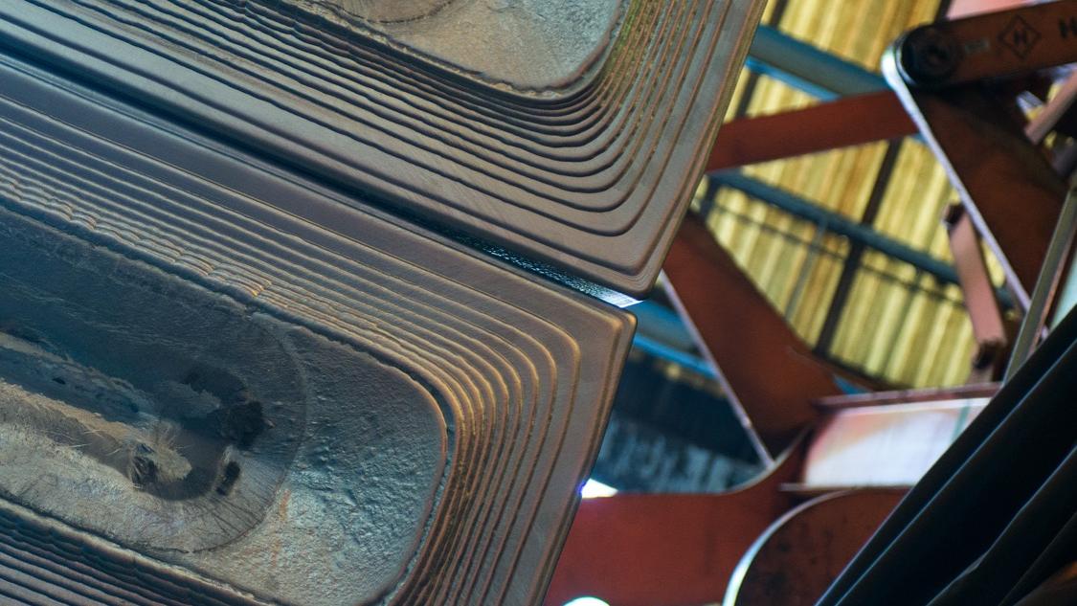

THANK YOU
QUESTIONS?

Slide 14
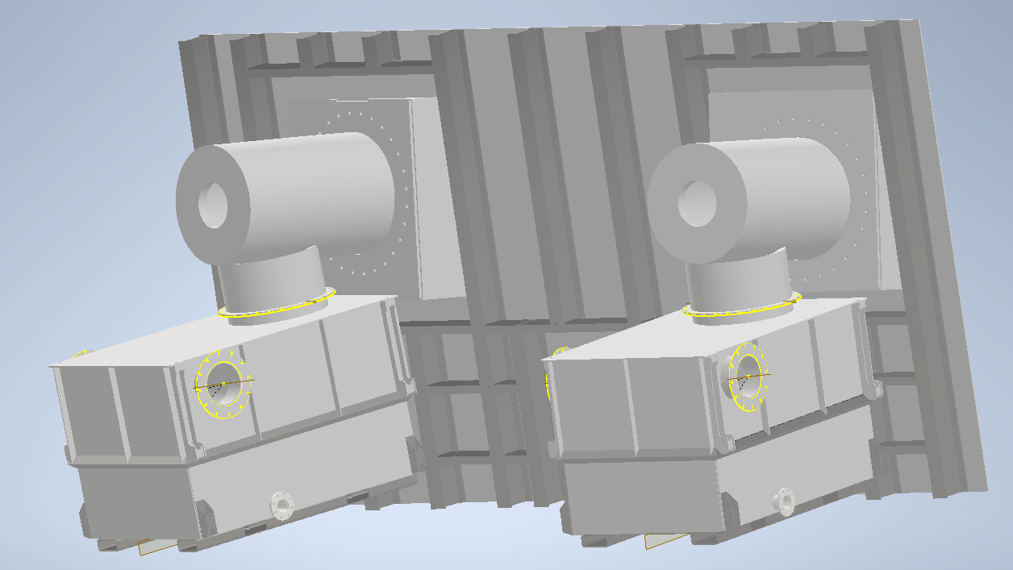
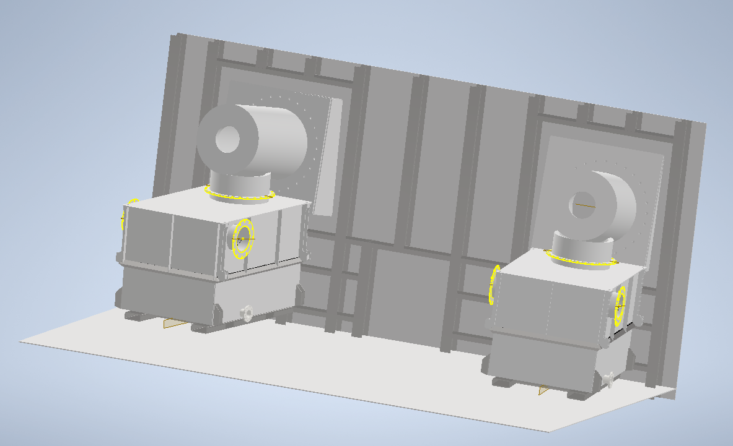
backup

